Slide 1

J.C. BOSE UNIVERSITY OF SCIENCE AND TECHNOLOGY ,YMCA , FARIDABAD
PROJECT PRESENTATION
ON
AI-DRIVEN PORTABLE WEATHER MONITORING AND PREDICTION SYSTEM
Submitted in fulfillment of requirement of the degree of
BACHELORS OF TECHNOLOGY
ELECTRONICS ENGINEERING SPECIALIZATION IN IOT
Presented by:
Aadarsh Mandal 22001017001
Rohit Yadav 22001017050
Shivam Upadhyay 22001017058
Dr. Mukesh Kumar
( Project Mentor )
Department Of Electronics Engineering

Slide 2
Table Of Content
Introduction
Problem Statement
Challenges
Impacts
Solution Overview
Approach
Target fields
Methodology
Flow diagram
Block diagram
Components
Challenges and Solutions
Conclusion

Slide 3
Introduction
AI-Based Portable Local Weather Monitoring System
Provides real-time, hyperlocal weather intelligence
Monitors: Temperature, Humidity, AQI, Wind Speed
Uses LoRa communication for long-range, low-power data transfer
Background
Traditional weather forecasts are broad and infrastructure-heavy
Dependence on internet connectivity limits rural/remote use
Lack of localized, real-time alerts in disaster-prone regions
High cost restricts deployment of conventional weather stations
Need for a portable, AI-driven, low-cost solution

Slide 4
Problem Statement
Lack of localized, real-time, low-cost forecasts
Challenges
Broad, non-specific forecasts
Dependence on internet connectivity
High cost & heavy infrastructure
Limited real-time alerts
Impacts
Vulnerable rural & remote communities
Poor disaster preparedness
Agricultural planning difficulties
Restricted large-scale deployment

Slide 5
Solution Overview
Approach
Portable, AI-enabled weather monitoring nodes
Collect data on temperature, humidity, AQI
Use LoRa communication ,low-power data transfer
AI algorithms for real-time prediction & localized alerts
Compact, low-cost, and scalable design
Target Fields
Agriculture – crop planning & protection
Disaster management – early warnings in prone areas
Rural & remote communities – independent weather monitoring
Temporary deployments – balloon-based or field operations

Slide 6
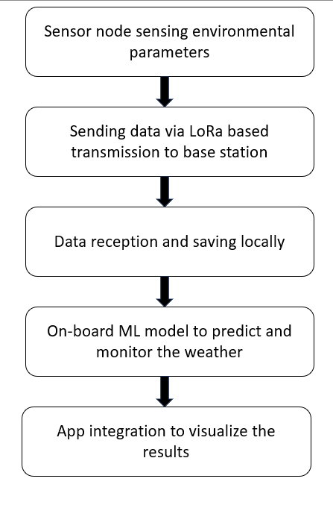


Methodology
Sensor node
Receiver Base Station

Slide 7
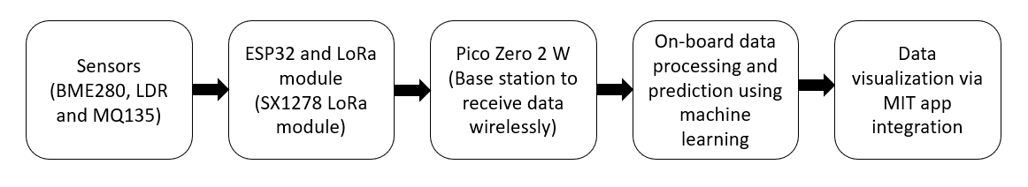
Block Diagram

Slide 8
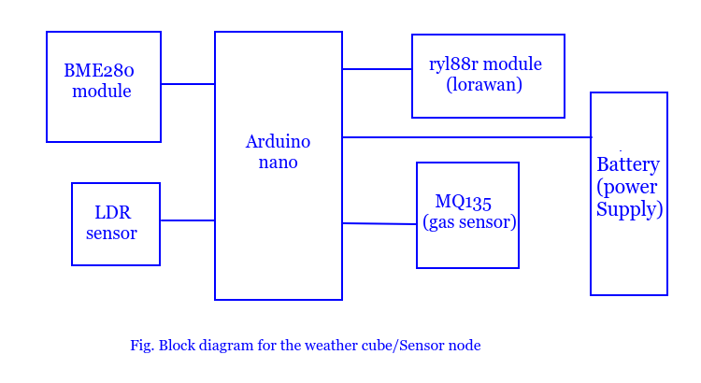
Block diagram

Slide 9
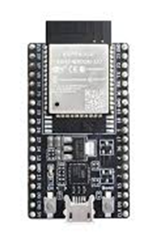
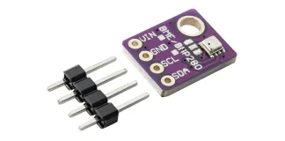
Components
ESP32 – Wi-Fi + Bluetooth-enabled microcontroller, low power, ideal for IoT.
ESP32 – Wi-Fi + Bluetooth-enabled microcontroller, low power, ideal for IoT.
BME280 – Bosch sensor measuring temperature, humidity, and pressure.

Slide 10
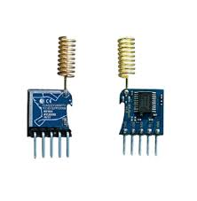
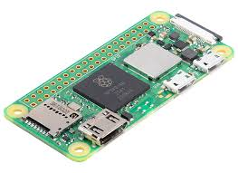
Components
ESP32 – Wi-Fi + Bluetooth-enabled microcontroller, low power, ideal for IoT.
rylr998 module - LoRa transceiver for long-range, low-power wireless communication.
Raspberry Pi Zero 2W – Compact, low-cost computer with Wi-Fi & Bluetooth.

Slide 11
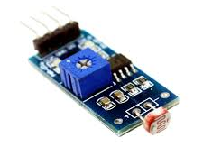
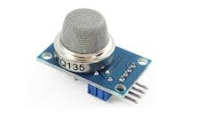
Components
ESP32 – Wi-Fi + Bluetooth-enabled microcontroller, low power, ideal for IoT.
MQ135 – Gas sensor for detecting air quality (CO₂, NH₃, smoke, etc.).
LDR Module – Light-dependent resistor, detects light intensity.

Slide 12
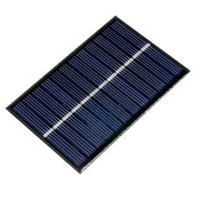
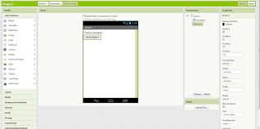
Components
ESP32 – Wi-Fi + Bluetooth-enabled microcontroller, low power, ideal for IoT.
Solar Panel – Converts sunlight into electricity using photovoltaic cells.
MIT App Inventor – Visual tool to build Android apps via drag-and-drop blocks.

Slide 13
Challenges & Solutions
ESP32 – Wi-Fi + Bluetooth-enabled microcontroller, low power, ideal for IoT.
Solutions
Use LoRa for long-range, low-power data transfer
Implement data compression & filtering
Integrate solar power + low-power design
Use robust enclosures for outdoor conditions
Design scalable, modular system for cost efficiency
Challenges
Limited communication range
Handling large data volume
Power management in field deployments
Weather durability of sensors & nodes
Maintaining low cost with reliability

Slide 14
Conclusion
ESP32 – Wi-Fi + Bluetooth-enabled microcontroller, low power, ideal for IoT.
Portable & scalable solution
AI-driven localized predictions
Works without internet dependency
Supports agriculture & disaster management
Low-cost, energy-efficient, real-time monitoring
Sensor node
Receiver Base Station

